Slide 1
Usability design discussion
Emily Li

Slide 2
User Journey
3 types of visitors
Visitors | Why they visit Lantern website?
Students/Teachers/Parents | Curious, Have questions, Want to help others
Researchers, Mental health professionals | Interested in Lantern, Comments/Suggestions as a professional. Want to contribute
Donors, Supporter, Contributor | Get to know Lantern Donate/Sponsor

Slide 3
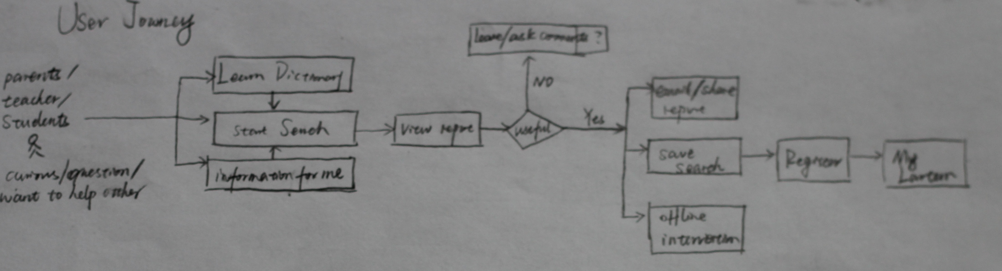
Students/teachers/parents

Slide 4
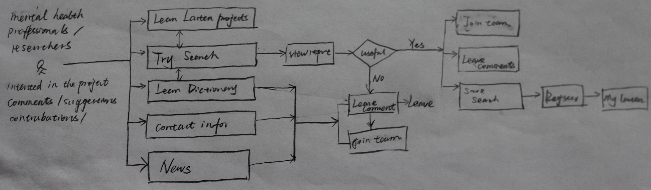
Researchers, Mental health professionals

Slide 5
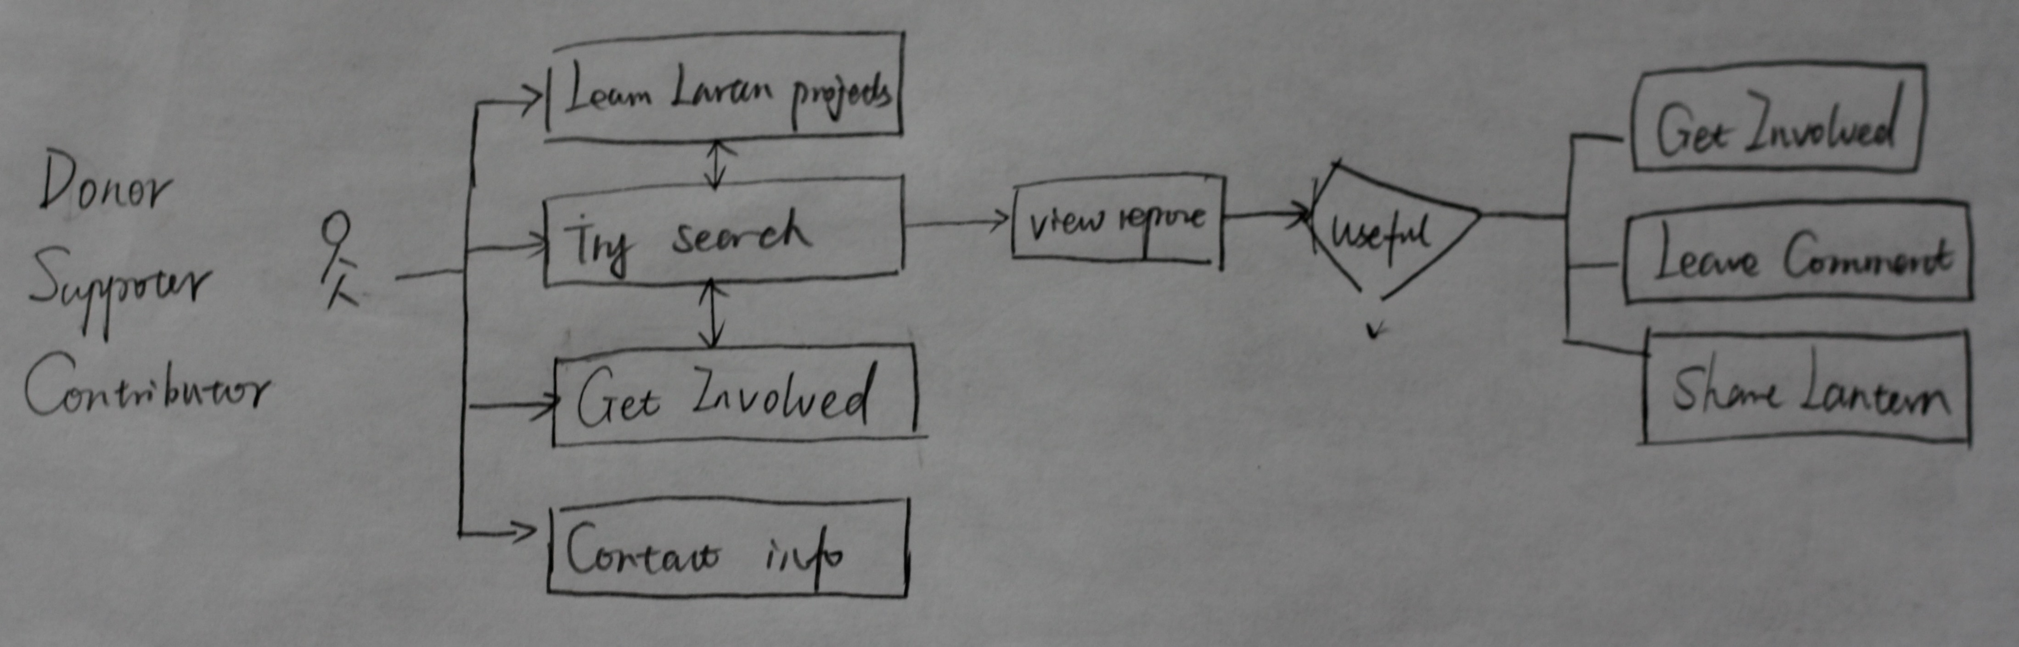
Donors

Slide 6
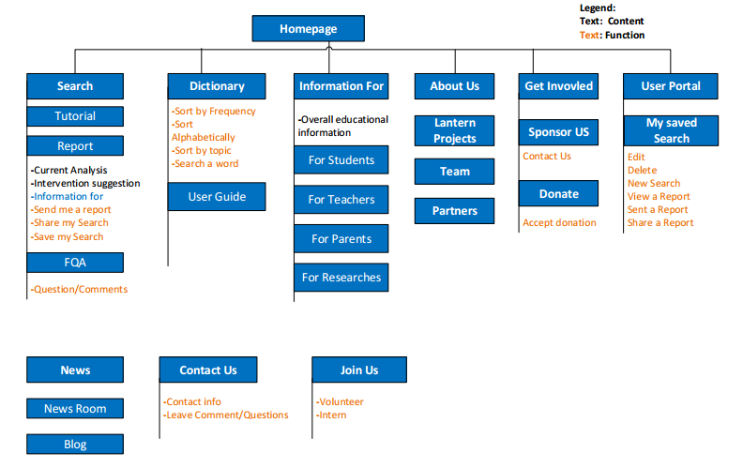
Information Architecture

Slide 7
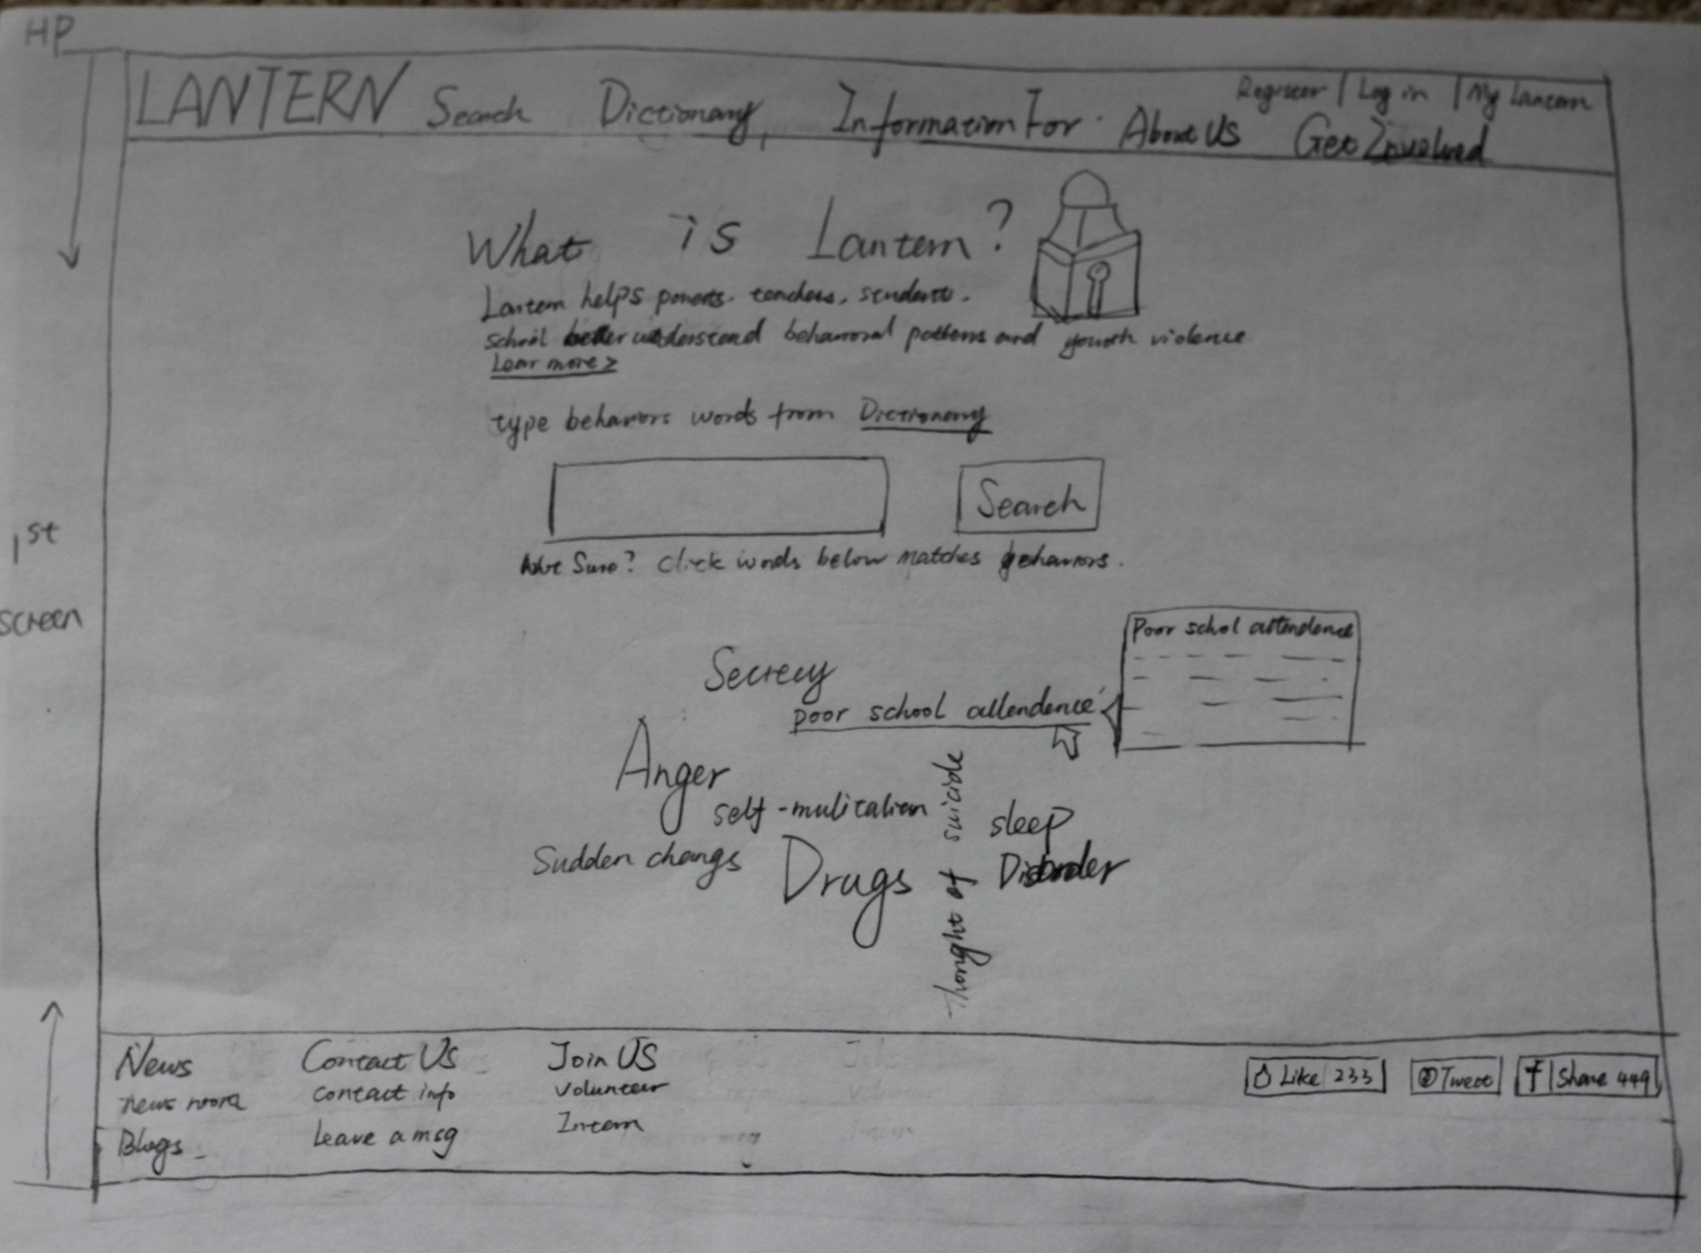
Homepage

Slide 8
Thanks!

